Slide 1
Wrangling Docker and Python
Leveraging Containerization to quickly Deliver Python Solutions
John Carnell Genesys
Notes:
Explore and validate whether Unikernels are a viable option for use in PureCloud.
We are use unikernels to reduce deployment times for services

Slide 2

About the Speaker
JOHN CARNELL is a lead cloud engineer at Genesys, where he works in Genesys’s PureCloud division. John spends the majority of his day hands-on building telephony-based microservices using the AWS platform. His day-to-day job is designing and building microservices across a number of technology platforms including Java, Clojure, Python, and Go.
John is a prolific speaker and writer. He regularly speaks at local user groups and has been a regular speaker on the “The No Fluff Just Stuff Software Symposium.” Over the last 20 years, John has authored, co-authored, and been a technical reviewer for a number of Java-based technology books and industry publications.
John holds a Bachelor of the Arts (BA) from Marquette University and a Masters of Business Administration (MBA) from the University of Wisconsin Oshkosh.
John can be reached at john_carnell@yahoo.com

Slide 3
Agenda
What is a microservice?
Building a Simple Python Microservice Using Flask
What is Docker?
Moving beyond the simple service
Deploying Multiple Services
Operationalizing Docker
Beyond running your own containers
Note: All code can be found at https://github.com/carnellj/spmia-chapter[1-10]
Notes:
How many of you guys are actively building microservice based applications
How many of you guys are Spring developers
Building them in the cloud

Slide 4
What is a Microservice?

Slide 5
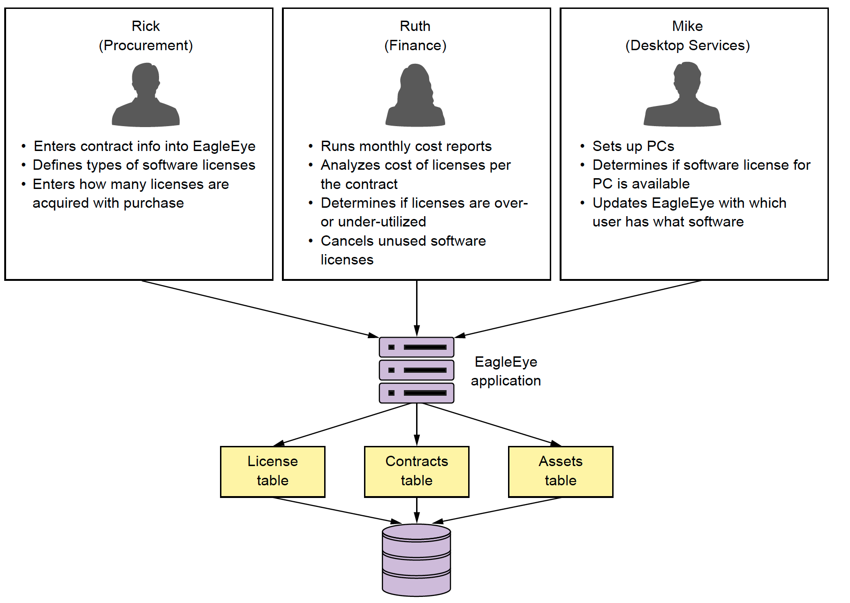
Lets build a Microservice: Start with a Problem
Notes:
Lets set the tone for the talk by setting the business problem. We have a small software company that makes licsense and asset management application. There traditional focus has been deliverying a monolithic web app, install on-premise to customers. They have a twice a year release cycle and it is killing the company in terms of getting the product out the door.

Slide 6
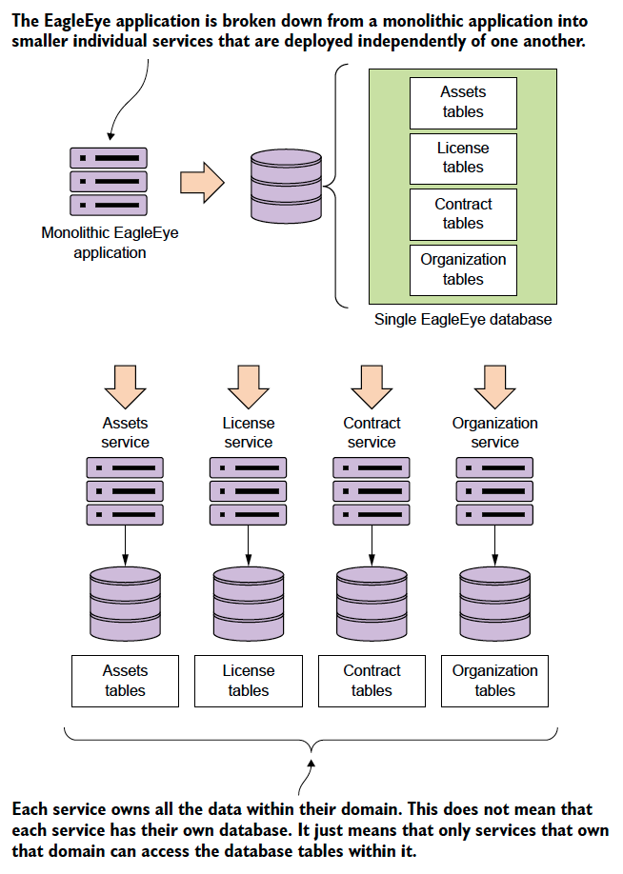
What is a Microservices: Decomposing the problem
Microservice are small, distributed software components that are:
Independently developed, tested and deployed from other software components in an application.
Are built around evolved principles (REST, JSON) rather then committee-based standards (No XML)
Very limited in scope of responsibility
Completely own their data
Are usually deployed in a loosely coupled fashion with synchronous and asynchronous interfaces
Their small size allows for rapid development and deployment of new features
Microservices are really a nature extension to the Agile and Lean movement shaping the software industry over the last 15 years
Microservices are pushing us to smaller batch sizes!
Notes:
To transition: Building microservices are easy. Its like building blog site in 10 minutes. :-)

Slide 7
Building your first Microservices with Python and Flask

Slide 8
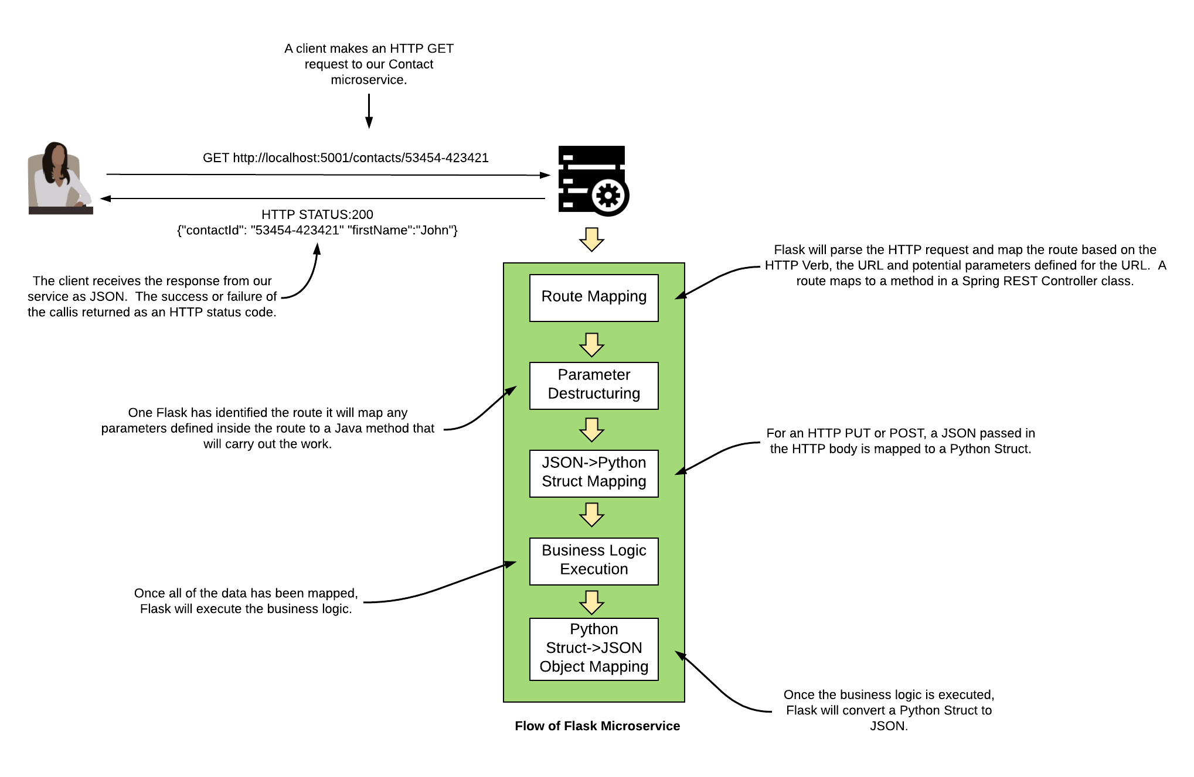
Lets build a simple microservice with Flask
What is Flask?
A very small HTTP-based web-service
Focuses heavily on building JSON-based, REST services
Annotation driven
Handles the most basic HTTP requests.
Notes:
Spring Boot really simplifies development of REST-based services by focusing on annotation development. Spring MVC is a full blown, full stack web development framework. Spring Boot is a very light weight framework

Slide 9
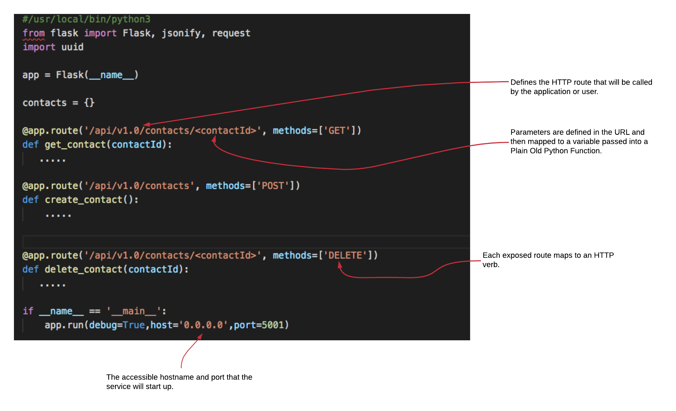
A Simple Contact Service

Slide 10
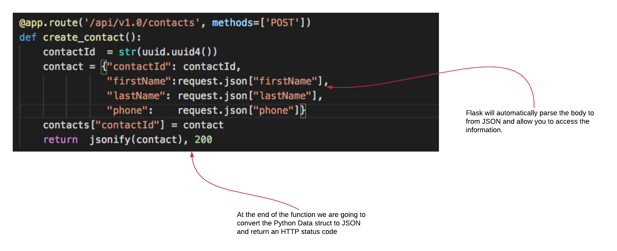
Creating a Contact with a POST

Slide 11
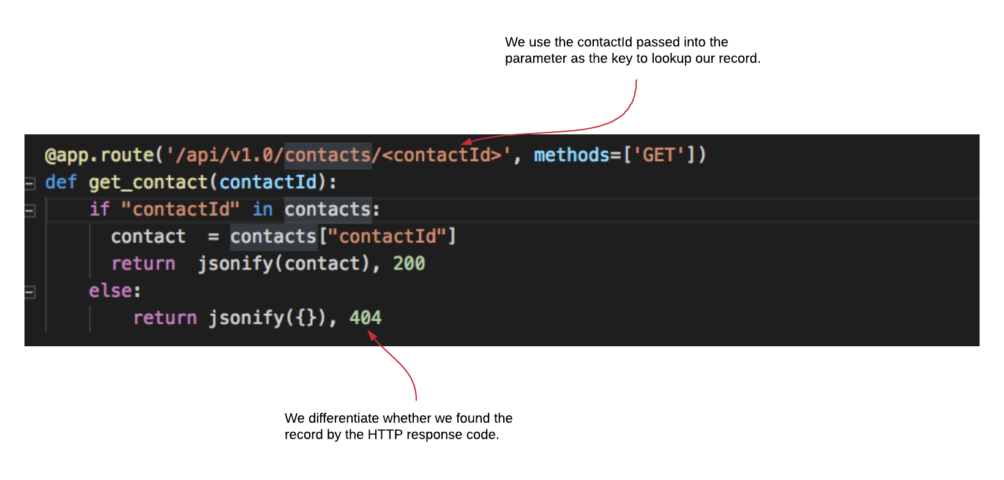
Retrieving a Contract with an HTTP

Slide 12
What is Docker?

Slide 13
What is Docker?
Docker is a container management platform
A container is a software image that is:
Lightweight
Stand-alone
Isolated
Portable across all environments
You run the same image across all environments
Notes:
Start with the story of 12000 configuration files and websphere. Configuration drift is really.
I cant stress this enough. How you manage the configuration of your application is critical. A microservice is a small independent piece of code that is self-contained and can be deployed quickly and repeatedly. It should be immutable meaning the server should not be touched

Slide 14
What are some use cases for Docker?
Packaging of local scripts and command-line tools
Build and deployment tools (Keep your build on your desktop and build on your server completely clean)
Service composition for local desktop environments (What You Build = What You Deploy)
Large Scale Microservice Deployment
Large Scale ETL, Data Processing
Functions as a Service

Slide 15
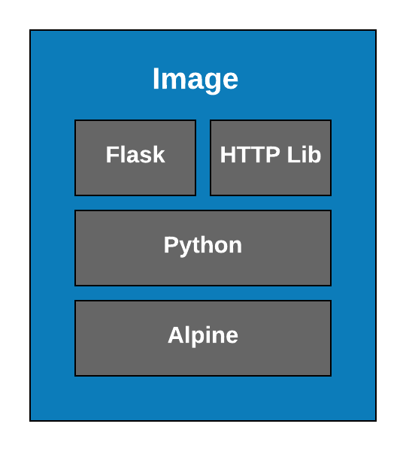
Everything in Docker Starts with An Image
Images are the self-contained, executables
You can start up an image
Once the image is baked it can not be changed
You can pass in environment variables to control behavior
Images are not full blown virtual machines
Best way to think about an image is that they do one thing really well.
Notes:
Start with the story of 12000 configuration files and websphere. Configuration drift is really.
I cant stress this enough. How you manage the configuration of your application is critical. A microservice is a small independent piece of code that is self-contained and can be deployed quickly and repeatedly. It should be immutable meaning the server should not be touched

Slide 16
How Do We Create an Image?
FROM python:3.6
RUN mkdir -p /usr/local/bin/simple-contact/
COPY requirements.txt /usr/local/bin/simple-contact/.
COPY contact.py /usr/local/bin/simple-contact/.
COPY DB.py /usr/local/bin/simple-contact/.
RUN pip3 install -r /usr/local/bin/simple-contact/requirements.txt
CMD python3 /usr/local/bin/simple-contact/simple-contact.py
docker build . –t simple-contact
Notes:
Start with the story of 12000 configuration files and websphere. Configuration drift is really.
I cant stress this enough. How you manage the configuration of your application is critical. A microservice is a small independent piece of code that is self-contained and can be deployed quickly and repeatedly. It should be immutable meaning the server should not be touched

Slide 17
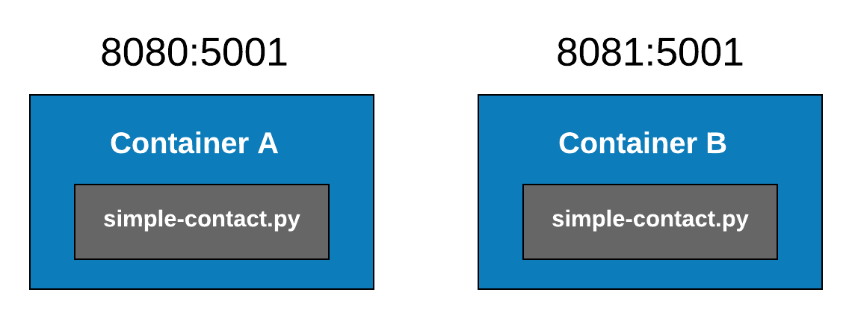
Great I have an image! Now what?
1
docker run -d --restart=always -p 8080:5001 simple-contact
X

Slide 18
Moving beyond a simple service: Docker Compose

Slide 19
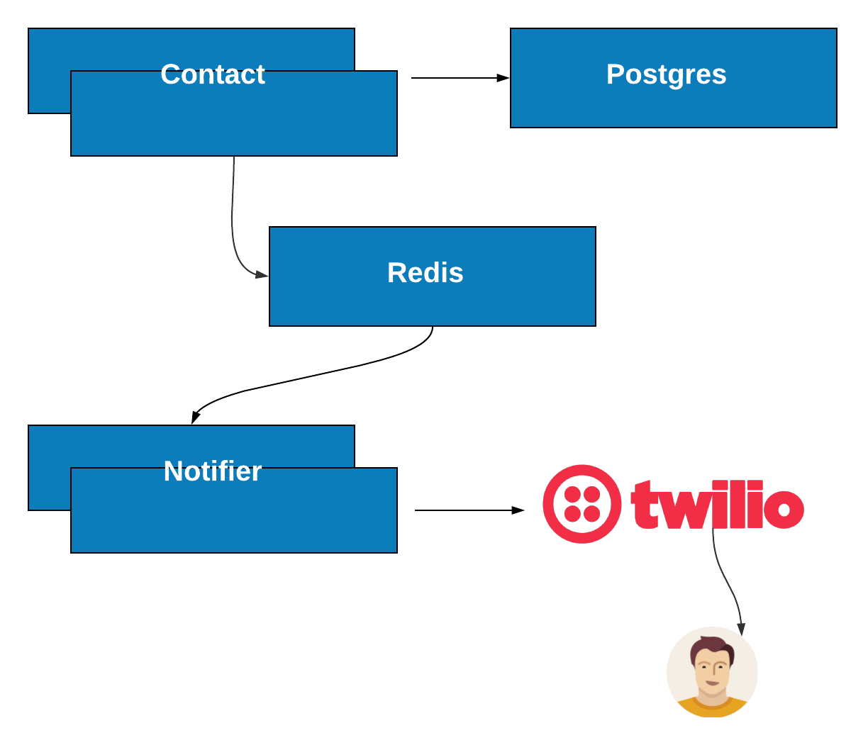
The real power of Docker comes when standing up the entire stack
The real power of Docker becomes apparent when you have to build a real application with real infrastructure.
We are going to build a text-to-speech application
This application will involve multiple pieces of infrastructure:
2 Python-based services
1 Postgres Database
1 Redis Cluster
A call out to Twilio
We could build and manage each of these infrastructure pieces ourselves, but that would be painful
We want to build and deploy the exact same environment we run locally to a prod environment.

Slide 20
How do we manage these containers as stack: Docker Compose
YAML based configuration tool that lets your define groups of containers that can be started and stopped with a single command
lets you define basically policies including:
How many containers you start per service
What is the restart policy if a container dies
Environment variables that should be passed to a service
Docker compose also helps you define both a default and custom networks to allow services:
To resolve other containers via DNS
Build ”firewalls” around individual services running in a container.
Notes:
One of my personal favor repositories is using github. You automatically get versioning for deployment options.

Slide 21
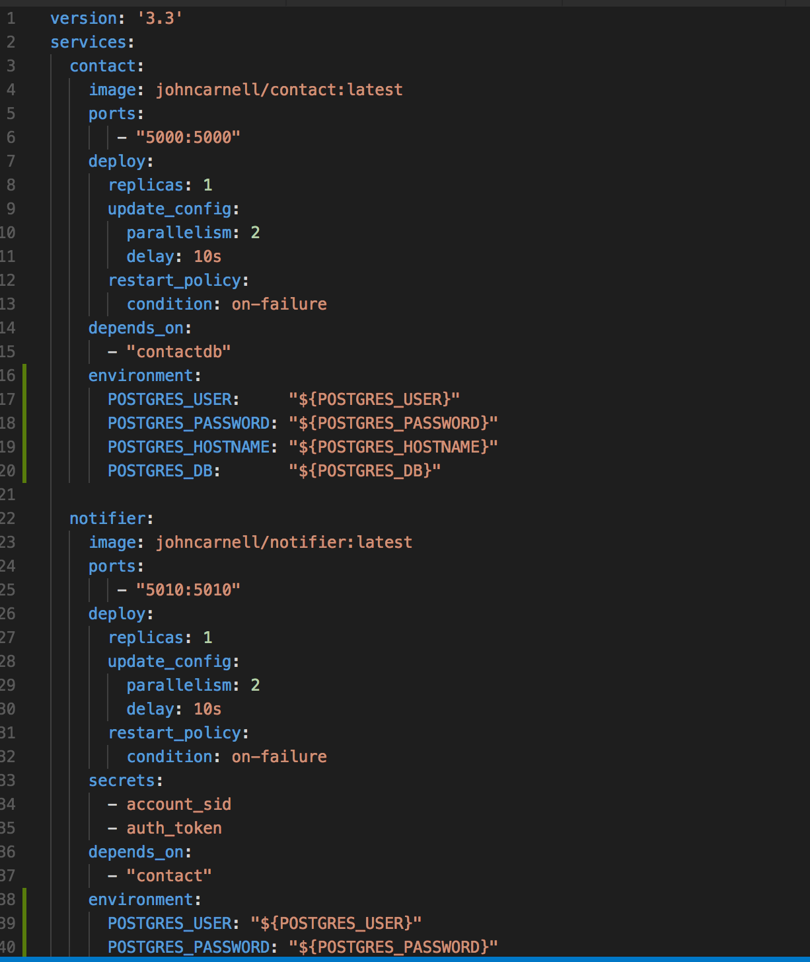
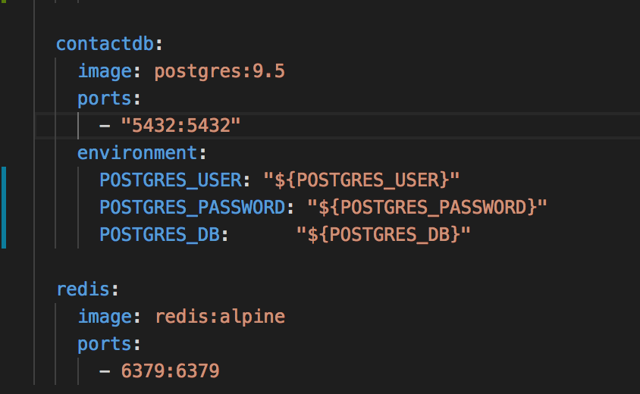
The Remind Me Apps Docker-Compose File
Notes:
Lets go look a the code.

Slide 22
The Docker-Compose file in more detail
Each service defines:
The name of the service
The ports it will expose
Any environment variables we are going to pass into the container
A docker-compose can contain a lot of other information.

Slide 23
Docker Containers are Portable but Environment Info is Not
Command line Environment Variables passed into Container
Environment variables are passed through docker-compose.yml file as hard-coded values
Environment variables passed through docker-compose.yml file using .env file.
Environment variables passed into the containers via Docker config and secrets

Slide 24
How do individual services know about each other: Networking
By default Docker will create an internal network that will resolve services to the service names via an internal DNS
However, Docker does allow you to segregate your container into separate networks and only specific endpoints to be exposed on your same network.

Slide 25
Deploying beyond a single service: Docker Swarm

Slide 26
What is a Docker Swarm?
Cluster Manager for Docker engines
Declarative Cluster Definition
Automated State Reconciliation
Service Discovery (Internally)
Load Balancing of Services
Automated Updates
Config and Secret Management
Notes:
Log aggregation

Slide 27
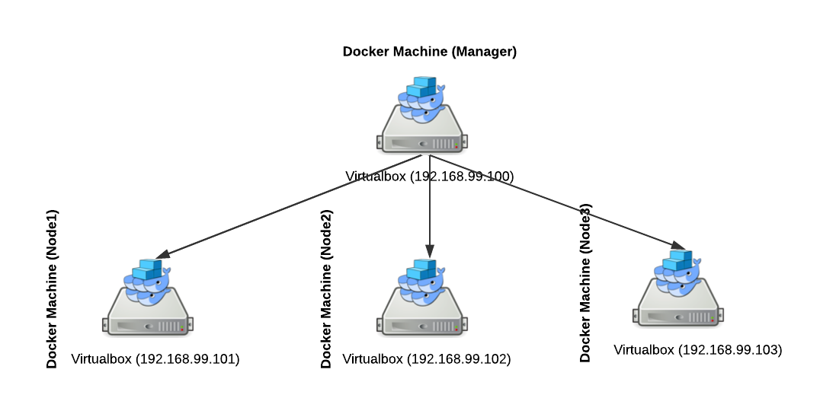
Our Docker Swarm
Each node will run in VirtualBox instance
Each VirtualBox instance will be created by docker-machine
The entire application stack deployed via docker-compose
Once it is deployed any service can be accessed via its defined port
Load Balancing will occur internally with each internal service lookup being done via load-balances DNS
Config and Secrets Management will be propagated to all the nodes (Raft Protocol)

Slide 28
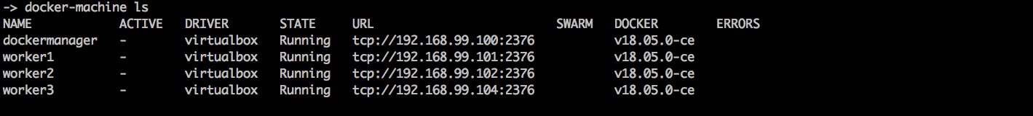
Step 1: Create the Virtualbox instances via Docker Machine
docker-machine create dockermanager -> docker-machine start dockermanager
docker-machine create worker1 -> docker-machine start worker1
docker-machine create worker2 -> docker-machine start worker2
docker-machine create worker3 -> docker-machine start worker3
You should now have four virtualbox vm’s running:

Slide 29
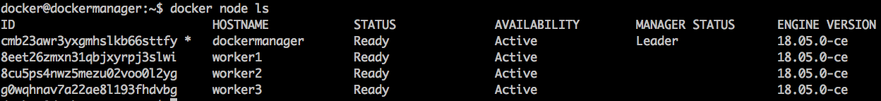
Step 2: Create the Cluster
docker ssh dockermanager
docker swarm init --advertise-addr 192.168.99.121
This will start a manager node and provide the token the worker nodes will use to join a cluster.
docker ssh worker (1,2,3)
swarm join --token SWMTKN-1-1oomcqtr470nf2tb9flpkh01c4nk1aghsbwlogpuq7ynqkcztd-7r5wbflb7b1ejmzdh88scm2kp 192.168.99.100:2377
docker swarm join-token worker | master

Slide 30
Step 3: Deploy the Application
docker-machine ssh dockermanager
docker stack deploy remindme --compose-file docker-compose-swarm.yml
docker node ps
docker node ps dockermanager | worker1 | worker2 |worker3
docker service scale remindme_contact=30
docker service scale remindme_contact=4

Slide 31
Step 4: Scaling your cluster
docker service scale remindme_contact=30
docker service scale remindme_contact=4

Slide 32
Step 5: Upgrading your cluster

Slide 33
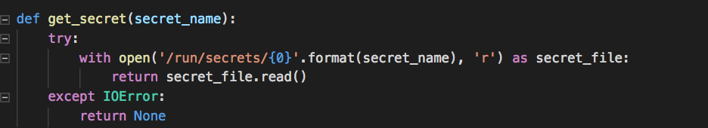
Give me all your secrets
With a swarm you want a way to safely share sensitive data across the nodes in the cluster.
Docker config will let you easily share non-encrypted information
Docker secret will let you easily share encrypted information
Docker will automatically write the config/secrets as file to each container
echo “Blah Blag”| docker secret create "account_sid" -
echo “Blah Blag”| docker secret create ”auth_token" -

Slide 34
Closing Thoughts on Docker Swarm
Docker Swarm is a great entry point for doing small-medium sized Docker Cluster deployments.
It has a rudimentary internal load balancer and you still need to use things like Zuul or HAProxy for external load-balancing.
When to use it vs. Kubernetes?
Kubernetes is a full blown container clustering solution
Can be complicated to setup and operationalize (even though Amazon is simplifying with FarGate)
Offers far more capabilities:
True service discovery
Better resource management and load allocation

Slide 35
Distributed service tracing with Python and Flask
Notes:
Microservice architectures are great because they break everything down into small pieces. Microservice architectures are extremely painful to debug because they break everything down into small pieces (especially if you have multiple teams). Log correlation, aggregation and tracing are critical to the success of your application because when u need logging (eg. critsits) is often when you dont have it.). We are going to look at how we can use Spring Cloud Sleuth with tools like Papertrail and Zipkin

Slide 36
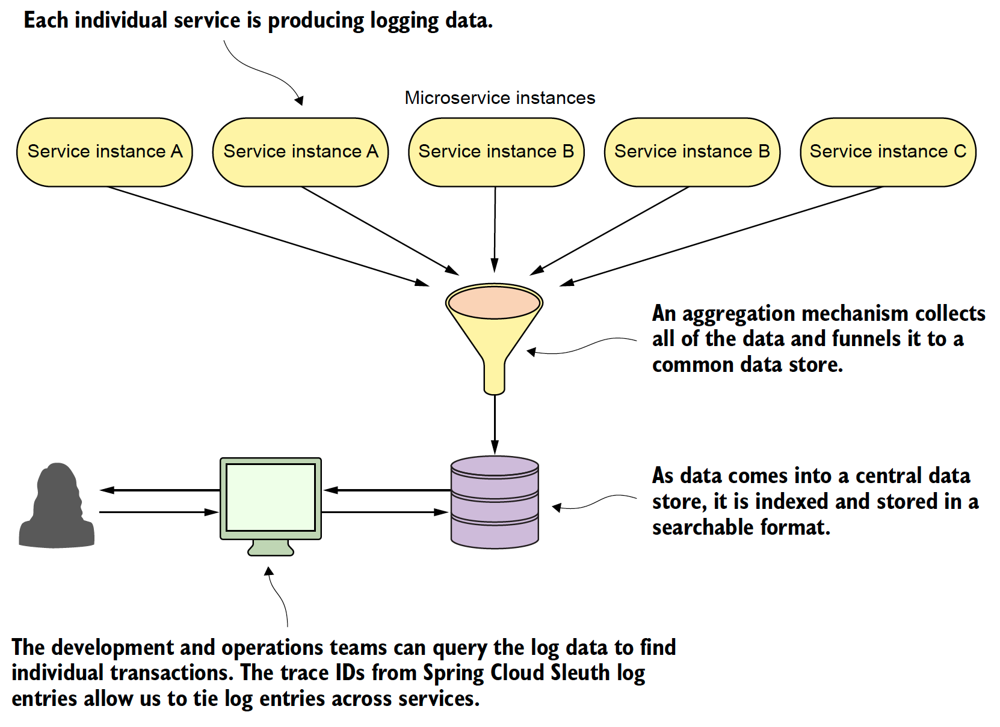
Log Aggregation and Distributed Tracing
Notes:
Log aggregation

Slide 37
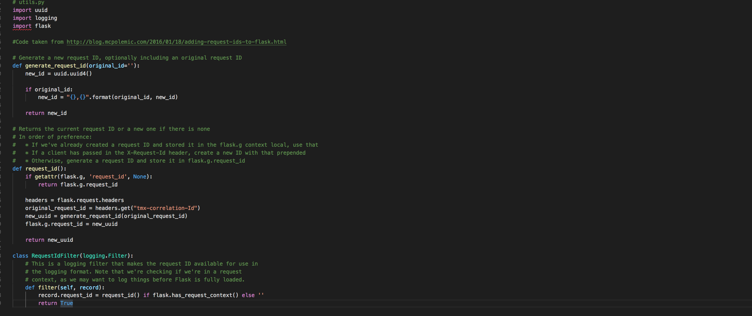
Step 1: Setup correlation ids in your services
Notes:
Spring Cloud sleuth really does a lot of behind the scenes magic with generating trace ids (correlation ids) and then making sure each segment of a call is broken down in a unique span.

Slide 38
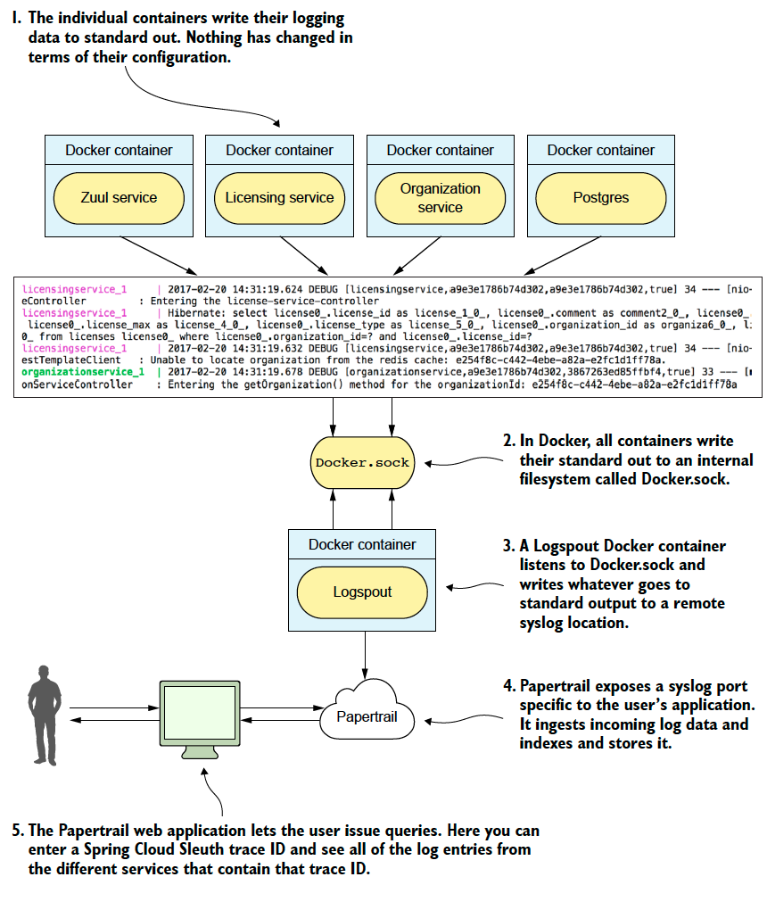
Step 2: Configure Log Aggregation and Papertrail
Notes:
Papertrail is just one log aggregation tool

Slide 39
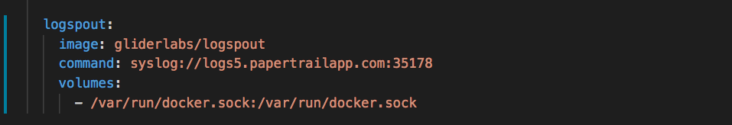
Adding Logspout to our Docker Compose File

Slide 40
Closing Thoughts

Slide 41
Closing thoughts
Docker Swarm is a great entry point for doing small-medium sized Docker Cluster deployments.
It has a rudimentary internal load balancer and you still need to use things like Zuul or HAProxy for external load-balancing.
When to use it vs. Kubernetes?
Kubernetes is a full blown container clustering solution
Can be complicated to setup and operationalize (even though Amazon is simplifying with FarGate)
Offers far more capabilities:
True service discovery
Better resource management and load allocation

Slide 42
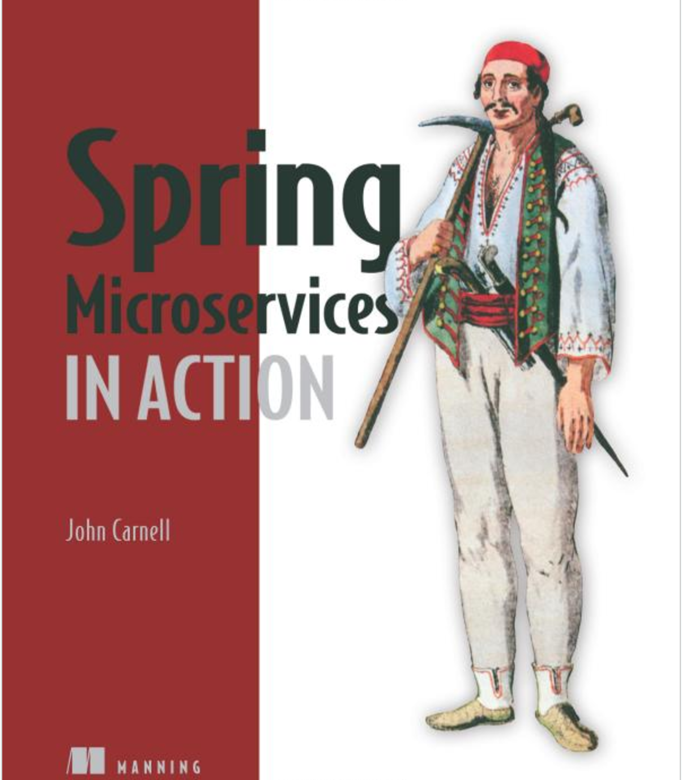
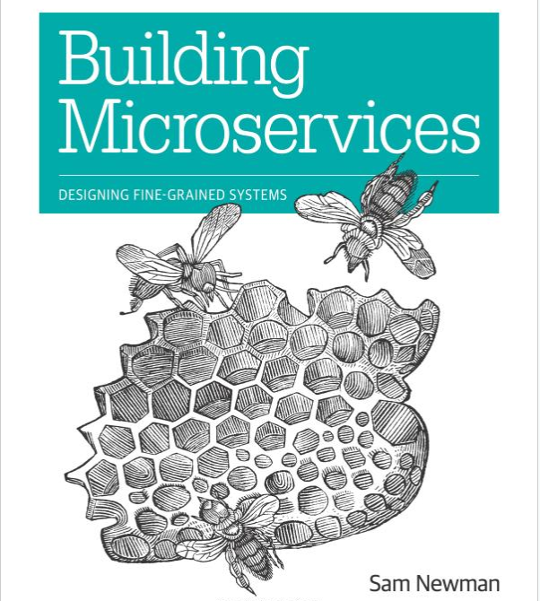

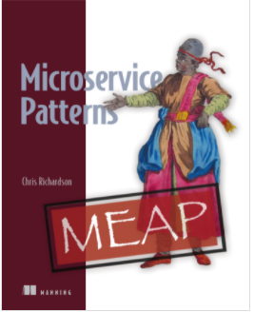
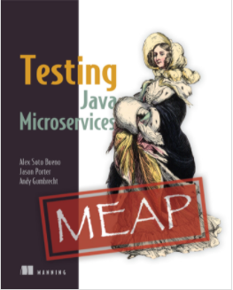
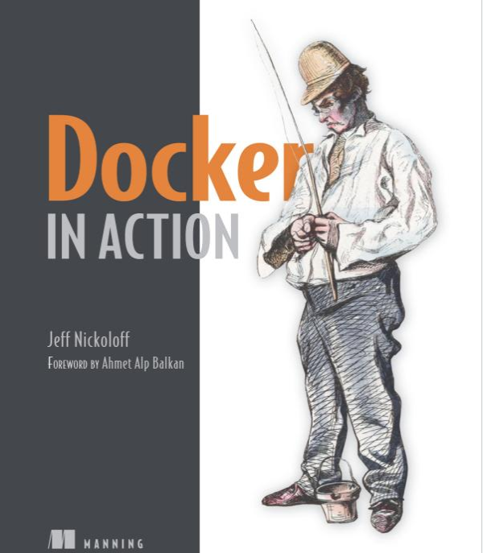
Other Microservice Resources

Slide 43
Questions

